Slide 1
The growing concern of mobile phone addiction
NAME – PRIYANSHU
CLASS – ITB2
ROLL NO – 2221132/2203872

Slide 2
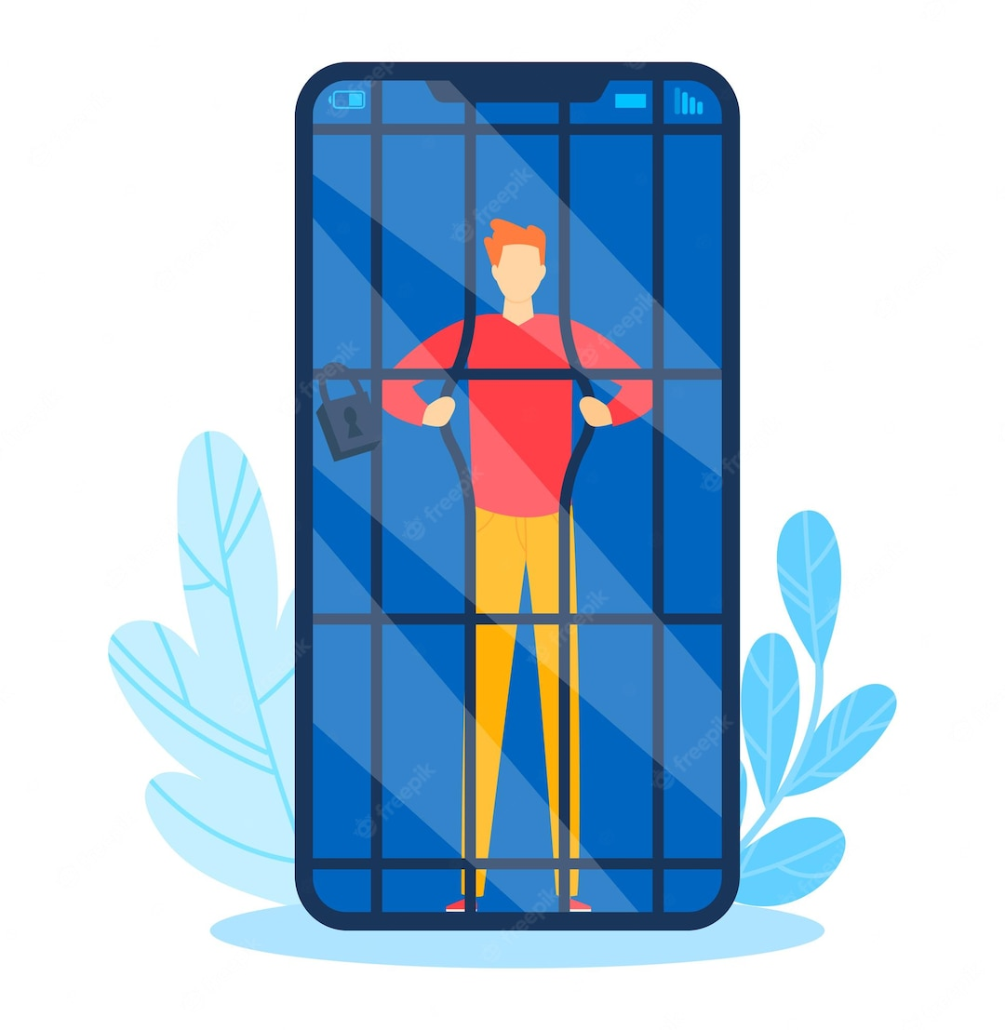
introduction
Phone addiction is the excessive and compulsive use of smartphones or mobile devices, leading to negative effect on daily life, productivity and metal well-being. It involves a strong urge to constantly check notification and online content ,often resulting in disrupted sleep, impaired social interactions and heightened anxiety.

Slide 3
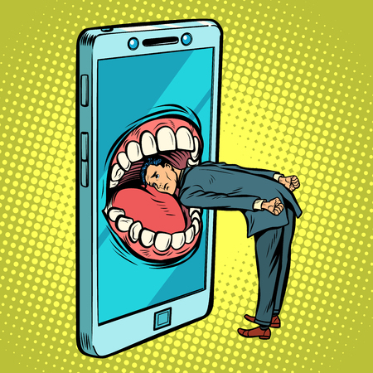
What is mobile phone addiction
Mobile phone addiction, also referred to as smartphones addiction, is a compulsive and excessive reliance on mobile phone or smartphone. It involves uncontrollable urge to use these devices for activities such as checking notifications, browsing social media, playing game and consuming online content.

Slide 4
The overall prevalence of mobile phone addiction was found to be 33.0% and was more among boys (33.6%) than girls(32.3%) .
Prevalence and statistics

Slide 5
Sign and symptoms
Common signs and symptoms of mobile phone addiction include excessive use of the phone ,inability to reduce usage despite wanting to neglecting other activities, disrupted sleep pattern, anxiety when separated from the phone, decreased face-to-face interaction and impaired concentration.

Slide 6
Factors contributing to mobile addiction
Constant Connectivity
App Design and Notifications
Entertainment and Content Consumption
Personalization
Social Validation
Escapism and Stress Relief
Technological Dependence
Gaming
Sleep Disruption
Digital Peer Pressure

Slide 7
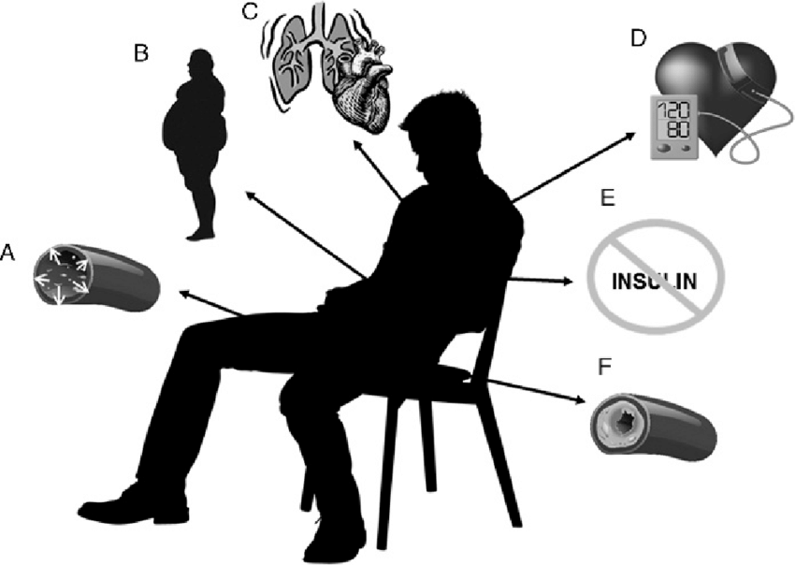
Impact on mental health
Text neck and Posture issues
Eye strain and Digital Eye syndrome
Sleep disruption
Increased sedentary behaviour
Reduced physical activities
Impaired vision
Impaired immune function
Increased risk of accidents

Slide 8
Impact on relationship
Reduced Quality time
Distracted conversations
Neglected attention
Decreased emotional connection
Miscommunication
Parent-child dynamics
Influence of children
Isolation

Slide 9
Tips for prevention
Set usage limit
Create phone-free zone
Disable non-essential notification
Practice mindfulness
Engage in offline activities
Priorities sleep
Use app blocker
Engaging in hobbies

Slide 10
Tips for prevention management
Practicing Digital detox
Practice the 20-20-20 rule
Uninstall unnecessary apps
Turn your phone grayscale
Track your usage
Seeking support
Develop real-world relationships
Set personal goal

Slide 11
Conclusion
Phone addiction is a going concern on individual’s mental health ,productivity and relationships. Its crucial to recognize the signs of addiction and take steps to address it.

Slide 12
Thank
You!

